Slide 2
Build It in the Room
What Developers Know About AI That Everyone Else Needs To
Jason Reiche & Gordon Inman | Rio Salado College | Thu, Oct 15, 3:15 PM, Room 1

Slide 3
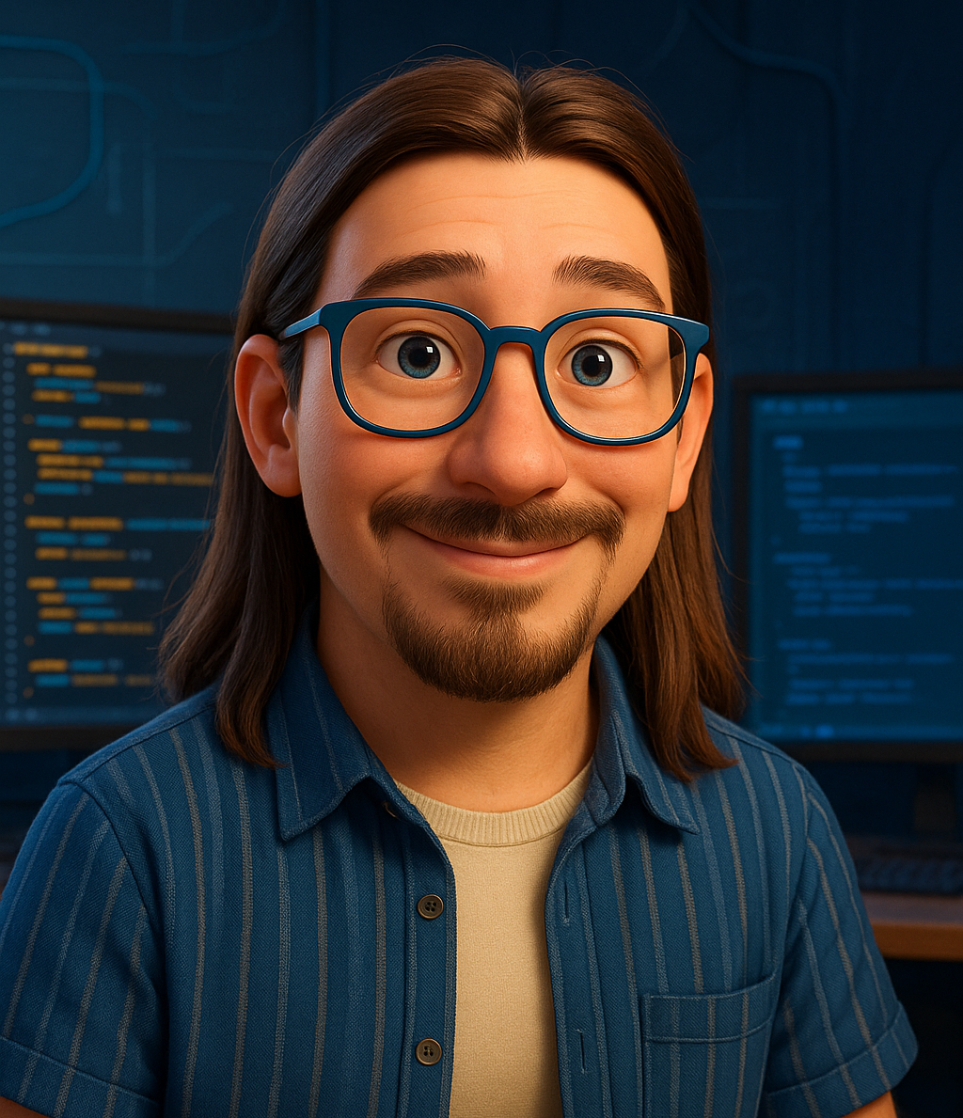

Your facilitators
Jason Reiche
Gordon Inman
Software Developer Senior
Tri-Chair, MCCCD AI Resource Center
Rio Salado College
Rio Salado College

Slide 4

Fork the starter kit and follow along
GET THE REPO
github.com/ExploreLearnMake/build-it-in-the-room
Fork it, or download the ZIP.
Open it in Claude Cowork, VS Code, or any AI coding tool.

Slide 5
Describe it. Hope. Spend an hour fixing it.
That's how most people build with AI today.

Slide 6
Developers write down what it must do before anyone builds
TODAY'S GOAL
You pick it
Specify
Plan
Tasks
Build
Demo
You propose a small tool and vote on it. We write its requirements together, then watch AI build it from those documents.
You leave with the templates and a starter repo to do the same next week.

Slide 7
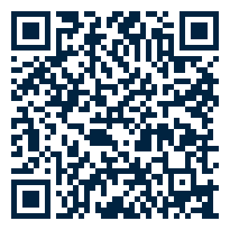
Pitch a tool, then vote for the one we build
IdeaBoardz
time
YOUR TURN
Keep it small enough to build in 15 minutes.
One screen, one kind of user, one job. Then +1 the idea you want built.
Examples: a five-question quiz, a branching scenario, a tuition or mileage calculator, a policy checklist.

Slide 8
Ship something small, then make it better
HOW DEVELOPERS THINK
Minimum viable product
The smallest version that does the one job
Sprints
Short build cycles with a review at the end of each
Fail forward
A broken first version tells you what to fix next

Slide 9
Vibe coding starts with a wish; spec work starts with a doc
TWO WAYS TO BUILD WITH AI
Vibe coding
Describe the idea in a chat
Accept what comes back
Fix by trial and error
Great for a quick sketch
Spec-driven development (SDD)
Write requirements first
AI asks questions before building
Each fix updates the document
Holds up as the project grows

Slide 10
Three documents, each answering one question
THE GROUNDWORK
SPEC
What must it do?
TAD
How does it do it?
ADR
Why is it built this way?
Every SPEC requirement is written in EARS. You only need the SPEC and the TAD to start.

Slide 11
EARS gives every requirement the same shape
EASY APPROACH TO REQUIREMENTS SYNTAX
Always
The quiz shall show one question at a time.
When (event)
When the learner submits an answer, the quiz shall show feedback.
While (state)
While a timer is running, the quiz shall display time remaining.
If (unwanted)
If no answer is selected, then the quiz shall disable Submit.
Where (option)
Where audio is enabled, the quiz shall read questions aloud.

Slide 12
A TAD says how the tool works and where it lives
TECHNICAL ARCHITECTURE DOCUMENT
Users and purpose
Who opens it, and what they need done
Work with your IT
Your platforms and rules shape the TAD. Bring them in early.
Platform
Decided ahead: a one-file embed for almost any site
Data
What it stores, and what it must never store
Constraints
Accessibility, privacy, no login
Out of scope
What we are deliberately not building

Slide 13
Accessibility is decided before the build, in ADR-001
ARCHITECTURAL DECISION RECORD
The decision
Everything we build targets WCAG 2.2 AA. WCAG 2.1 AA is the floor.
The AI reads this file before writing any code.
Why it matters
The ADA Title II web rule requires WCAG 2.1 AA for public colleges and agencies.
DOJ moved the large-entity deadline to April 26, 2027. The standard didn't change.

Slide 14
Let the AI interview you before it builds anything
IdeaBoardz
vote closes
SPARRING BEFORE BUILDING
"Before you write any code, interview me. Ask one question at a time about who will use this, what it must do, what it must not do, and how we'll know it works."
Then ask it to argue with your plan. Gaps show up in the questions you can't answer.

Slide 15
Plain-text Markdown files are the project's memory
Browser
repo tour
SETTING UP THE PROJECT
build-it-in-the-room/
AGENTS.md map for any AI agent
CLAUDE.md notes just for Claude
docs/SPEC.md
docs/TAD.md
docs/TASKS.md
docs/ADRs/ decisions made up front
prompts/ prompts we used
skills/ platform know-how
builds/ finished tools
Why Markdown
Humans and AI both read it easily.
Any tool can open it, so your docs outlive whichever AI you use this year.

Slide 16
Now we build it, in the room
Specify › Plan › Tasks › Implement

Slide 17
Turn the room's answers into SPEC.md
Claude
Prompt 01
STEP 1 OF 4: SPECIFY
Specify
Plan
Tasks
Implement
Claude asks questions; you answer them.
Every answer becomes an EARS requirement.
We read the spec back before moving on.

Slide 18
Write the plan into TAD.md
Claude
Prompt 02
STEP 2 OF 4: PLAN
Specify
Plan
Tasks
Implement
Claude writes TAD.md from the spec and ADRs.
We check it against the spec and ADR-001.
Anything not in the spec gets cut.

Slide 19
Break the work into small, ordered steps
Claude
Prompt 03
STEP 3 OF 4: TASKS
Specify
Plan
Tasks
Implement
Claude writes TASKS.md from the spec and TAD.
Each task is small enough to check.
Order follows dependencies.

Slide 20
Hand the documents to the AI and let it build
Claude
Prompt 04
STEP 4 OF 4: IMPLEMENT
Specify
Plan
Tasks
Implement
The AI works from the docs, not from memory of the chat.
We test against the spec as it builds.
If live AI fails, we switch to the finished calculator in the repo.

Slide 21
The same pattern works in any of these tools
TOOLS
Claude Chat
Talk it through and draft documents
Claude Cowork
Works with files and folders on your computer
Claude Code
Builds and edits code in a project
Also worth a look: Cursor, AWS Kiro (built around specs), Google Antigravity, GitHub Copilot in VS Code, ChatGPT Codex.
The documents are what carry over. The tool is your choice.

Slide 22
Demo: does it do what the spec says?
Browser
live demo
We test the tool against the requirements you wrote.

Slide 23
Where it lives next is a conversation with your IT team
NEXT STEPS
Inside your LMS
Embed in Canvas or CourseArc
Claude Artifacts
Share a link to a hosted page
GitHub Pages
Free static hosting from the repo
For campus work, ask IT what's approved. For personal projects, ask Claude to walk you through the options.

Slide 24
Take the templates and try it on one tool next week
TAKEAWAYS
Write requirements before you prompt.
Let the AI interview you first.
Keep the docs in the project, not in the chat.
Start with something small enough to finish.

Slide 25
Questions?
Repo and templates: github.com/ExploreLearnMake/build-it-in-the-room

Slide 26
Fallback tool if the vote doesn't produce a buildable idea
APPENDIX
Default concept: a trip fuel cost calculator (distance, MPG, gas price, round trip, split the cost).
Finished version is in the repo at builds/trip-cost-calculator/index.html. Open it in a second tab before the session.
Its SPEC, TAD, and TASKS are in examples/trip-cost-calculator/, so the walkthrough still holds.

